Slide 1



Administrator
Logged on
Bindows Vista Ultimate

Slide 2
Logging off…
Bindows Vista Ultimate

Slide 3
Restarting…
Bindows Vista Ultimate

Slide 5
eBox
Reboxing in this forever.
F10 - Startup options
DEL – Setup
F11 – View all hardware installed
_

Slide 7
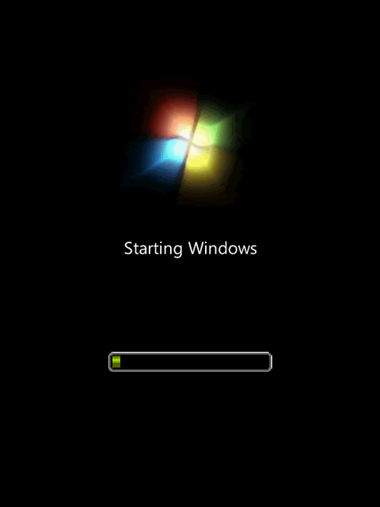
2016 © BubbleSoft Corporation.

Slide 9



Slide 11
Administrator
Bindows Vista Ultimate

Slide 12
Welcome
Bindows Vista Ultimate

Slide 13
Computer

Slide 14
Computer
X
Coming soon features here! :D
Computer
View the system information
View the Binver
Go to control panel

Slide 15
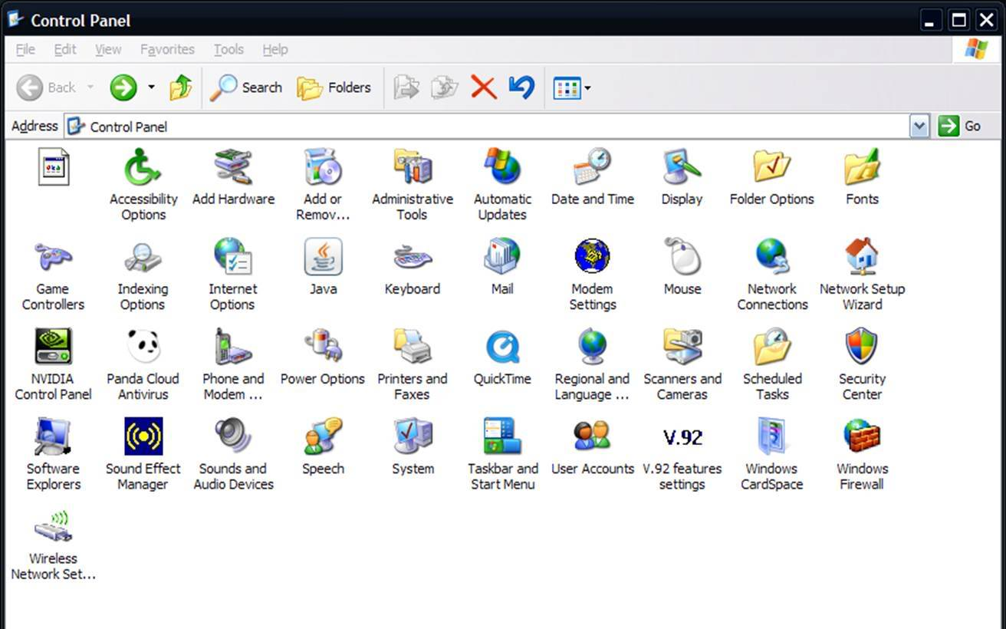



Control Panel
X
View the system information
View the Binver
control panel
Computer
Display
User
accounts

Slide 16

Display
X
Computer
Bindows Vista Aero
Vista Classic
OK

Slide 17

User accounts
X
Computer
Administrator
Owner
OK

Slide 18
Up Browser - Error
X
http://www.sjaskansjkna.com
->
Computer
Up Browser cant found the solicited website
Error 404 Website/server/data/DNS not found

Slide 19
BubbleSoft Mail
X
Welcome!
Sent by: BubbleSoft
Welcome to BubbleSoft Mail!
Welcome
Computer

Slide 20
System Information
X
Computer
BubbleSoft Bindows Vista
Service Pack 1
Copyright © 2015 BubbleSoft & PC
OK

Slide 21
About Bindows
X
Bindows Vista Ultimate
Copyright © 2015 BubbleSoft & PC
Computer
BubbleSoft Bindows Vista
Service Pack 1 (Build 6429)
Copyright © 2015 BubbleSoft & PC
OK

Slide 22

Up Browser
Internet
Computer
BubbleSoft Mail
Mail
Shutdown
>

Slide 23
Up Browser
Internet
Computer
BubbleSoft Mail
Mail
Restart
Logoff
Shutdown
>
Change user

Slide 24
Bindows Vista
Computer
Turn off your computer to save the data on the disk.
Shutdown
Cancel

Slide 25
Logging off…
Bindows Vista Ultimate

Slide 26
Shutting down…
Bindows Vista Ultimate

